Slide 1
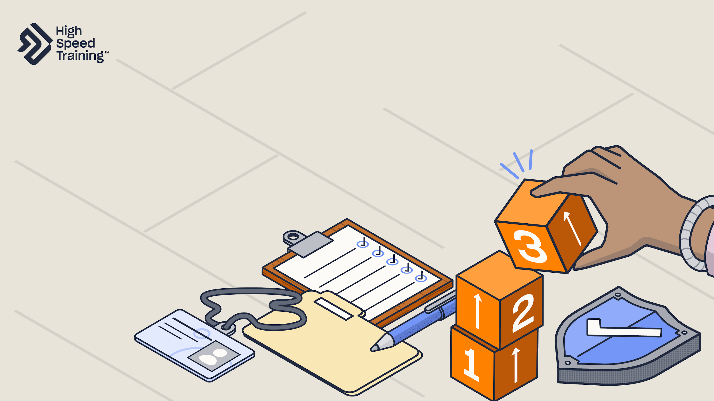
Write your school name here
INSET 2024
Safeguarding
1
Notes:
Please note: a document containing the facilitator notes can be found in your INSET pack and you can refer to these throughout the presentation.
Welcome staff to your Safeguarding INSET.
Point out that staff may take a break from today’s session at any point if they find any details distressing.

Slide 2

Topics to cover
Statutory safeguarding guidance
Types of abuse
Safeguarding issues
Reporting safeguarding concerns
Creating an effective safeguarding culture
Notes:
Read out the topics to cover in today’s session.
Throughout the presentation, there will be a number of opportunities for interactivity with video content, scenarios and discussion points.
If staff have questions at any point, advise that they can ask them in front of the group during the session, or wait until the end to speak to a member of the safeguarding team.

Slide 3


Everyone has a responsibility to promote the welfare of, and to safeguard, children and young people.
Notes:
Every member of staff has a responsibility to promote the welfare of, and to safeguard, children and young people.
Whilst it is not a comfortable thought, it is essential that you take the view that it could happen to children in your school and more than that - it may well be happening.
You should never underestimate the part that you play in protecting children.

Slide 4
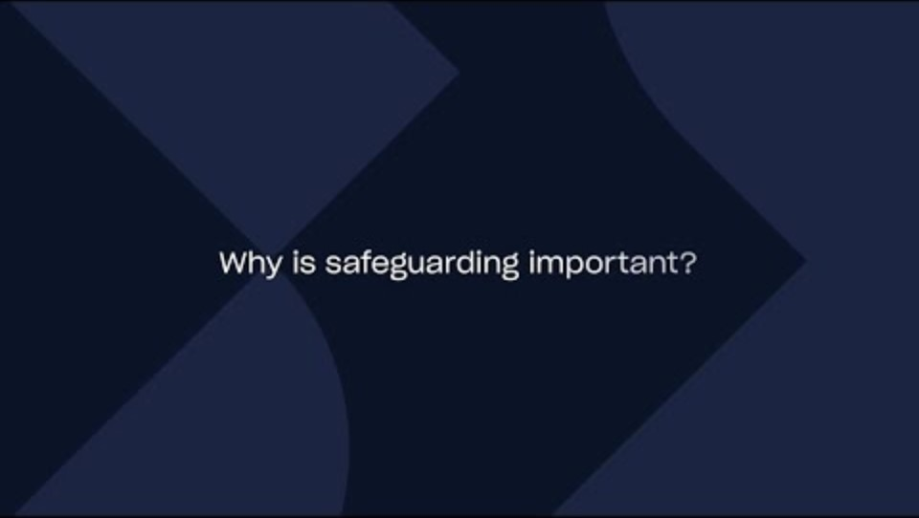
Notes:
Video content: when presenting the slide, click on the play icon to start the video (02:05).
Let staff know that you are going to play a video to introduce today’s session, covering what safeguarding means and why it is so important.
You’ll hear from a range of experts including Joanna Nicolas, Debbie Innes-Turnill and Ian Curry.
If you need the link to access the video, you can find it here: https://www.youtube.com/watch?v=wLJBPrapAzE

Slide 5

Write your school name here
Safeguarding team
>>INSERT NAME<< - Designated Safeguarding Lead (DSL)
>>INSERT NAME<< - Deputy DSL
Notes:
Please note: you should edit the details regarding your safeguarding team before presenting this slide.
Remind staff that your safeguarding team is here to help.
Go through the details of team members that you have added into the slides, making sure staff are aware of who they should speak to about safeguarding.

Slide 6

Statutory safeguarding guidance (KCSIE and WTSC)
Write your school name here
2
Notes:
The first section of today’s session will focus on key updates to statutory safeguarding guidance, including Keeping Children Safe in Education and Working Together to Safeguard Children.
You’ll cover the key updates and what the changes mean for schools.
It also includes a useful pull-out document for easy access to more detailed information which can be forwarded onto staff.

Slide 7

Keeping Children Safe in Education (KCSIE)
Key changes for 2024:
Amending the definition of ‘safeguarding and promoting the welfare of children’ to reflect the updated Working Together to Safeguard Children 2023.
Added information about ‘early help’ in line with Working Together to Safeguard Children 2023.
The term ‘exploitation’ has been included throughout the guidance, amended from just abuse and neglect.
Two separate age-appropriate guides have now been included for schools to support children in the court system.
Clarification that schools remain responsible for the pupils they place in alternative provision.
Key changes for 2024:
Amending the definition of ‘safeguarding and promoting the welfare of children’ to reflect the updated Working Together to Safeguard Children 2023.
Added information about ‘early help’ in line with Working Together to Safeguard Children 2023.
The term ‘exploitation’ has been included throughout the guidance, amended from just abuse and neglect.
Two separate age-appropriate guides have now been included for schools to support children in the court system.
Clarification that schools remain responsible for the pupils they place in alternative provision.
Guidance for schools and colleges on safeguarding children and safer recruitment.
Notes:
Keeping Children Safe in Education sets out the legal duties you must follow to safeguard and promote the welfare of children and young people under the age of 18 in schools and colleges.
Similar to the previous year, the changes for 2024 are quite minimal. A lot of the changes relate to the amendments to Working together to safeguard children 2023.
Outline some of the changes to be aware of as shown on the screen.
All school and college staff should read part 1 of this guidance.
Sources of information:
https://www.gov.uk/government/publications/keeping-children-safe-in-education--2
https://www.highspeedtraining.co.uk/hub/keeping-children-safe-in-education-changes/?utm_source=insetpack2024&utm_medium=insetpack2024&utm_campaign=insetpack2024

Slide 8
Working Together to Safeguard Children (WTSC)
The 2023 guidance update includes:
Recognising that improvements must be made to involve families more closely.
Emphasis on securing ‘positive, trusting and cooperative relationships’ with parents and carers.
New multi-agency practice standards to strengthen cooperation between services.
Revised guidance on improving provision for disabled children and their families.
Guidance on recognising and responding to risk of harm to children outside the home.
Recognises that safeguarding is most effective when everyone involved works together collaboratively.
Notes:
Working Together to Safeguard Children highlights the importance of multi-agency working and outlines the value of involving the whole family in the process, including the child.
The 2023 guidance update emphasises securing ‘positive, trusting and cooperative relationships’ with parents and carers.
It also explains the importance of considering the needs of the whole family. For example, families with English as an additional language (EAL) may require more specialist support to keep them involved and informed.
In addition, the new version of the guidance outlines new roles within the local authority, the police and health services. It states that the head of each sector will be named the Lead Safeguarding Partner (LSP), and they must appoint a Delegated Safeguarding Partner (DSP). It is expected that LSPs will form close relationships with representatives from the education sector, who should also be involved in any strategic decisions and planning.
Sources of information:
https://www.gov.uk/government/publications/working-together-to-safeguard-children--2
https://www.highspeedtraining.co.uk/hub/working-together-to-safeguard-children/?utm_source=insetpack2024&utm_medium=insetpack2024&utm_campaign=insetpack2024

Slide 9
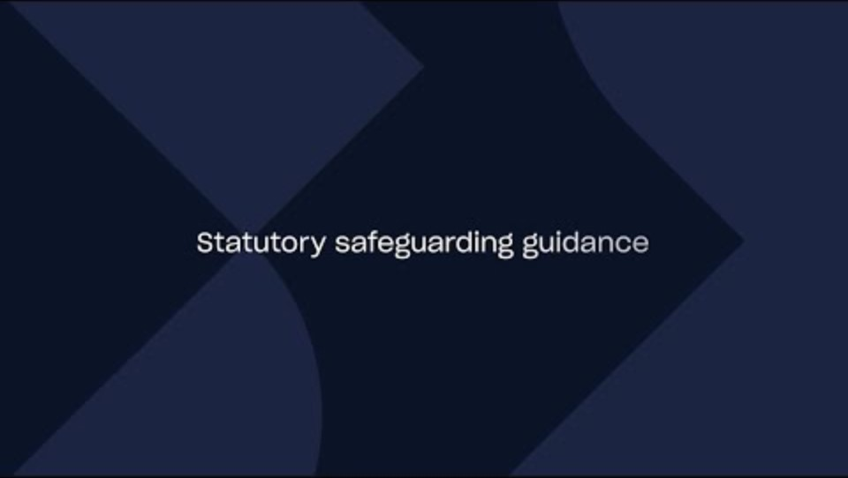
Notes:
Video content: when presenting the slide, click on the play icon to start the video (00:00).
In this video, staff will hear from Debbie Innes-Turnill. You’ll be informed about the key changes to statutory safeguarding guidance and what this means for schools.
If you need the link to access the video, you can find it here: https://youtu.be/0wBhxZI93yc

Slide 10
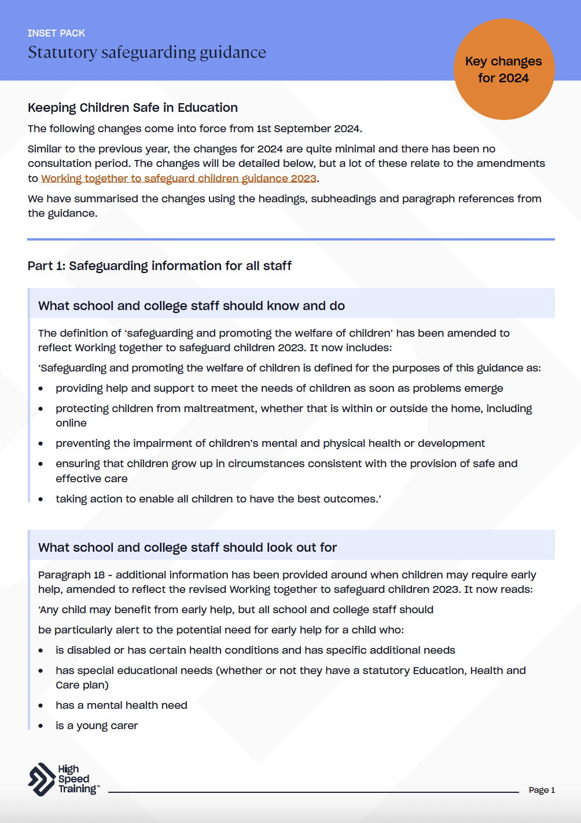
The changes and updates have been compiled in this document, using the headings, subheadings and paragraph references from the guidance.
Notes:
Please note: you can find this document within your pack.
This pull-out document contains more detailed information on the updates.

Slide 11
Summary
Legislation and guidance change regularly, so it’s important that you always keep up to date with current guidance.
You can access the latest documents at: https://www.gov.uk/education/safeguarding-pupils
Notes:
Provide a summary of the section that you have just covered on statutory safeguarding guidance.
Offer the opportunity for staff to ask any questions that they may have following this section.

Slide 12


Further resources and training
If you would like to find out more about the topics we’ve covered in this section, visit the following links:
Keeping Children Safe in Education: Key Changes
Working Together to Safeguard Children: Key Changes
Safeguarding Children Legislation: Guidance for Schools
Safeguarding Courses
Notes:
If staff would like to find out more about topics covered in this section, advise them that they can visit the links as shown.

Slide 13
The four main types of abuse
Write your school name here
2
Notes:
The second section of today’s session will focus on the four main types of abuse.
You’ll cover the different types of abuse and the signs to look out for that may suggest a cause for concern.

Slide 14




Child abuse is often categorised into four types
Physical abuse
Neglect
What does this include?
Emotional abuse
Sexual abuse
Notes:
There are four main categories of abuse.
Encourage staff to say these aloud before you click to reveal them one-by-one on the slide.
This includes physical abuse, emotional abuse, neglect and sexual abuse.
These should not be thought of as clear-cut categories and it’s important to remember that there is often significant overlap between these.
Keep in mind that sometimes a child may be experiencing different forms of maltreatment at the same time.

Slide 15
Physical abuse
Physical abuse is when someone intentionally causes physical harm to a child. This includes hitting, shaking, throwing, poisoning, burning, or scalding, drowning, suffocating, or otherwise causing physical harm.
Physical harm may also be caused when a parent or carer fabricates the symptoms of, or deliberately induces, illness in a child (Fabricated Induced Illness – FII).
Signs to look out for
Bruises
Scarring
Burns or scalds
Fractures
Bite marks
Drowsiness, seizures and vomiting
Notes:
Physical abuse is when someone intentionally causes physical harm to a child.
This includes: hitting, shaking, throwing, poisoning, burning, or scalding, drowning, suffocating.
Physical harm may also be caused when a parent or carer fabricates the symptoms of, or deliberately induces, illness in a child (Fabricated Induced Illness).
Outline some of the signs to look out for as shown on the slide.
It’s important to remember that children can have accidents, trips and falls. However, regular injuries, those unusual for their developmental age, when there seems to be a pattern, on the soft parts of the body or where the explanation doesn't match the injury, may be cause for concern.
Sources of information:
https://assets.publishing.service.gov.uk/media/65cb4349a7ded0000c79e4e1/Working_together_to_safeguard_children_2023_-_statutory_guidance.pdf
https://www.nspcc.org.uk/what-is-child-abuse/types-of-abuse/physical-abuse/

Slide 16
Emotional abuse
Emotional abuse refers to the persistent emotional maltreatment of a child such as to cause severe and persistent adverse effects on the child’s emotional development.
This includes trying to scare, humiliate, isolate or ignore a child:
Telling children they are worthless unloved or inadequate.
Not giving the child opportunities to express their views, deliberately silencing them or ‘making fun’ of what they say or how they communicate.
Age or developmentally inappropriate expectations being imposed. Either beyond a child’s developmental capability or overprotection and limitation of exploration and learning, or preventing the child participating in normal social interaction.
Serious bullying (including cyberbullying) causing children frequently to feel frightened or in danger, or the exploitation or corruption of children.
Signs to look out for
Lacking social skills
Having few friendships
Seeming isolated from their parents or carers
Using language inappropriate for their age
Struggling to control emotions
Lacking confidence and being anxious
Being aggressive to other children
Younger children being overly affectionate or clingy towards strangers
Notes:
Emotional abuse refers to the persistent emotional maltreatment of a child, causing severe and persistent adverse effects on the child’s emotional development.
This includes: trying to scare, humiliate, isolate or ignore a child.
Some level of emotional abuse is involved in all types of maltreatment of a child, though it may occur in isolation.
It can also be referred to as psychological abuse.
Outline some of the signs to look out for as shown on the slide.
Sources of information:
https://assets.publishing.service.gov.uk/media/65cb4349a7ded0000c79e4e1/Working_together_to_safeguard_children_2023_-_statutory_guidance.pdf
https://www.nspcc.org.uk/what-is-child-abuse/types-of-abuse/emotional-abuse/

Slide 17
Sexual abuse
Sexual abuse involves the forcing or enticing of a child or young person to take part in sexual activities, not necessarily involving a high level of violence, whether or not the child is aware of what is happening.
The activities may include both contact and non-contact abuse:
Contact abuse is where an abuser makes physical contact with a child. This may involve assault by penetration (for example, rape or oral sex) or non-penetrative acts, such as masturbation and kissing.
Non-contact abuse involves non-touching activities such as forcing a child to look at sexual images or witness sexual activity, encouraging children to behave in sexually inappropriate ways or grooming a child in preparation for abuse (including via the internet).
Signs to look out for
Appearing afraid to socialise or interact with a certain person
Unexplained injuries or bruises
Pregnancy
Sexually transmitted infections or or urinary tract infections
The use of sexual language inappropriate for their age
Secretiveness
Notes:
When a child is sexually abused, it means that they have been forced or enticed to taking part in sexual activities.
They may not understand that it’s wrong for the abuser to do this to them.
Child sexual abuse includes both contact and non-contact abuse:
Contact abuse is where an abuser makes physical contact with a child. This may involve assault by penetration (for example, rape or oral sex) or non-penetrative acts, such as masturbation and kissing.
Non-contact abuse involves non-touching activities such as forcing a child to look at sexual images or witness sexual activity and sharing pornography.
It’s vital to note that sexual abuse can take place in person or online.
Outline some of the signs to look out for as shown on the slide.
Sources of information:
https://assets.publishing.service.gov.uk/media/65cb4349a7ded0000c79e4e1/Working_together_to_safeguard_children_2023_-_statutory_guidance.pdf
https://www.nspcc.org.uk/what-is-child-abuse/types-of-abuse/child-sexual-abuse/

Slide 18
Neglect
Neglect is the persistent failure to meet a child’s basic physical and/or psychological needs, likely to result in the serious impairment of the child’s health or development.
It may involve a parent or carer failing to:
provide adequate food, shelter or clothing,
protect from physical and emotional harm or danger,
ensure adequate supervision (including use of inadequate carers)
ensure access to medical care or treatment.
Signs to look out for
Appearing hungry as though they may have gone without breakfast
Being without adequate clothing
Appearing to care for family members
Skin sores, rashes, flea bites, scabies or ringworm
Having poor hygiene, being visibly dirty or smelling
Not meeting developmental milestones
Repeated injuries caused by lack of supervision
Notes:
Neglect is the persistent failure to meet a child’s basic physical and/or psychological needs.
There are four main types of child neglect which includes: physical neglect, educational neglect, medical neglect, and emotional neglect.
Be clear that poverty does not equal neglect, but there are often strong links between the two.
Outline some of the signs to look out for as shown on the slide.
Sources of information:
https://assets.publishing.service.gov.uk/media/65cb4349a7ded0000c79e4e1/Working_together_to_safeguard_children_2023_-_statutory_guidance.pdf
https://www.nspcc.org.uk/what-is-child-abuse/types-of-abuse/neglect/

Slide 19

Discussion point
Remember that some individuals may be more at risk. In which circumstances might we need to be extra vigilant?
Notes:
Remind staff that any child can be at risk of maltreatment. However, we know that some circumstances may increase that risk.
Discussion point: in which circumstances might we need to be extra vigilant?
Once you have given staff the chance to discuss, you can provide examples such as:
Children with special educational needs and disabilities (SEND)
Children with mental health difficulties
Looked after children (LAC)
Children missing education
Children who identify as LGBTQ+
Children with previous experience of abuse
Unmet parental mental health needs and parental substance misuse

Slide 20
Summary
The four main types of abuse include physical abuse, emotional abuse, sexual abuse and neglect.
There is often significant overlap between the different types of abuse.
It is essential that we are able to recognise indicators that may suggest a cause for concern.
Notes:
Provide a summary of the section that you have just covered on the four main types of abuse.
Offer the opportunity for staff to ask any questions that they may have following this section.

Slide 21
Further resources and training
If you would like to find out more about the topics we’ve covered in this section, visit the following links:
Signs of Abuse in Children
Child Sexual Abuse: Guidance for Schools
How to Teach Children About Healthy Relationships
Understanding Why Children May Stay Quiet About Abuse
Notes:
If staff would like to find out more about topics covered in this section, advise them that they can visit the links as shown.

Slide 22
Safeguarding issues
Write your school name here
3
Notes:
The third section of today’s session will focus on a selection of key safeguarding issues.
You’ll cover online safety, Prevent, mental health and child-on-child abuse.

Slide 23


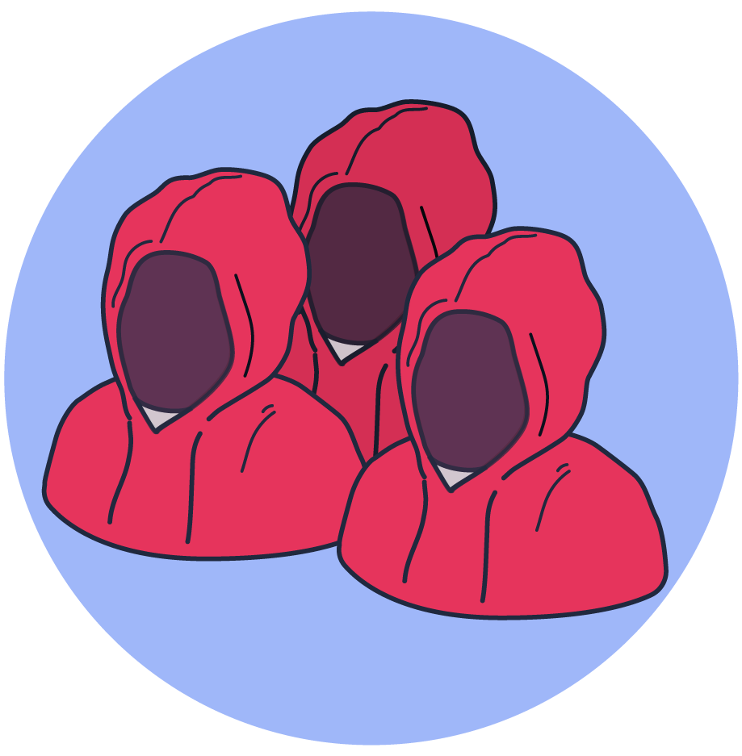

The four categories of online risks defined by KCSIE include
ONLINE SAFETY
Content risks – being exposed to illegal, inappropriate or
harmful content.
Commerce risks – risks with a financial implication.
Conduct risks – online behaviour that increases
the likelihood of, or causes, harm.
Contact risks – being subjected to harmful online interaction with other users.
Notes:
Tell staff that you are going to talk about online safety.
All children who access the internet are susceptible to online harm.
The breadth of issues classified within online safety is considerable and ever evolving.
Click to reveal the text that explains KCSIE categorises online risks into the four Cs.
Encourage staff to say these aloud before you click to reveal them one-by-one on the slide.
This includes content, commerce, contact and conduct.
These categories are not mutually exclusive. Many online experiences, such as gaming, may carry risks in more than one, or even all, of these areas.
Sources of information:
https://assets.publishing.service.gov.uk/media/6650a1967b792ffff71a83e8/Keeping_children_safe_in_education_2024.pdf
https://learning.nspcc.org.uk/news/2023/september/4-cs-of-online-safety

Slide 24

Child-on-child abuse
Adults posing as children
Artificial intelligence
Live chat
Inappropriate language
Sending and receiving explicit images
Risks
Grooming
Fake news
Cyberbullying
Radicalisation
Sextortion
Financial scams
Notes:
Tell staff that you are now going to look at some of the risks associated with being online.
You could ask staff to think about what comes to their mind.
Click to reveal a variety of online safety risks.

Slide 25


A combination of the words ‘sex’ and ‘extortion’ and refers to a type of financially-motivated online blackmail.
It commonly involves the non-consensual sharing of ‘nudes’ or ‘semi-nude’ photos and videos in exchange for money.
Whilst sextortion is commonly perpetrated by criminal gangs - and therefore by a stranger to the child - it can also be carried out by someone the victim knows.
Sextortion
A recent sextortion case that made the news is that of Murray Dowey, a 16-year-old boy who took his own life in December
2023 as a result of being a victim of sextortion.
Notes:
Ask staff to define what they think is meant by sextortion and click to reveal the details on screen.
It commonly involves the non-consensual sharing of ‘nudes’ or ‘semi-nude’ photos and videos in exchange for money.
Sextortion is very distressing, upsetting, embarrassing and stressful for the child or young person experiencing it, and the perpetrators usually prey on these feelings, knowing they can get more out of the child or young person because they’ll be too ashamed to report what’s happening to them.
A few signs of sextortion to look out for include:
A child or young person suddenly having a new boyfriend/girlfriend, who they met online or on a social media app (like Snapchat, Instagram, or TikTok).
The child or young person appearing withdrawn or worried and not being their ‘usual self’.
Parents may report that their child has been using their device a lot more than usual, resulting in tiredness due to spending time online.
It is easy to assume that sexual imagery is likely to have been shared by a teenager but sextortion can also target younger children.
This can happen to anyone from any background and at any age. Providing age-appropriate education is key.
A recent sextortion case that made the news is that of Murray Dowey, a 16-year-old boy who took his own life in December 2023 as a result of being a victim of sextortion. The teenager from Scotland had been targeted by criminals and duped into thinking he was talking to a teenage girl on social media. The ‘girl’ shared an intimate image with Murray who responded by sharing an intimate image of himself. At that point, it was immediately revealed that he’d been talking to criminals, who proceeded to ask Murray for money and threatened to share the intimate image with all his contacts if he didn’t pay up.
Sources of information:
https://www.highspeedtraining.co.uk/hub/what-is-sextortion/?utm_source=insetpack2024&utm_medium=insetpack2024&utm_campaign=insetpack2024
https://www.theguardian.com/society/2024/apr/29/it-can-happen-to-any-child-parents-of-sextortion-victim-fight-for-justice
https://www.theguardian.com/society/2024/apr/29/teachers-warned-to-be-on-lookout-for-victims-of-sextortion-in-uk-schools
https://www.ceopeducation.co.uk/professionals/guidance/fmse-alert/

Slide 26

32%
of 8-17 year olds say they have seen something they found worrying or nasty online in the last 12 months
Discussion point
How can we help encourage our pupils to share when they have concerns online?
Notes:
Read the statistic from Ofcom, stating that 32% of 8-17 year olds say they have seen something they found worrying or nasty online in the last 12 months.
Discussion point: how can we help encourage our pupils to share when they have concerns online?
Allow time for discussion and then take some of the answers to summarise thoughts from the group.
Sources of information:
https://www.ofcom.org.uk/media-use-and-attitudes/media-habits-children/a-window-into-young-childrens-online-worlds/

Slide 27
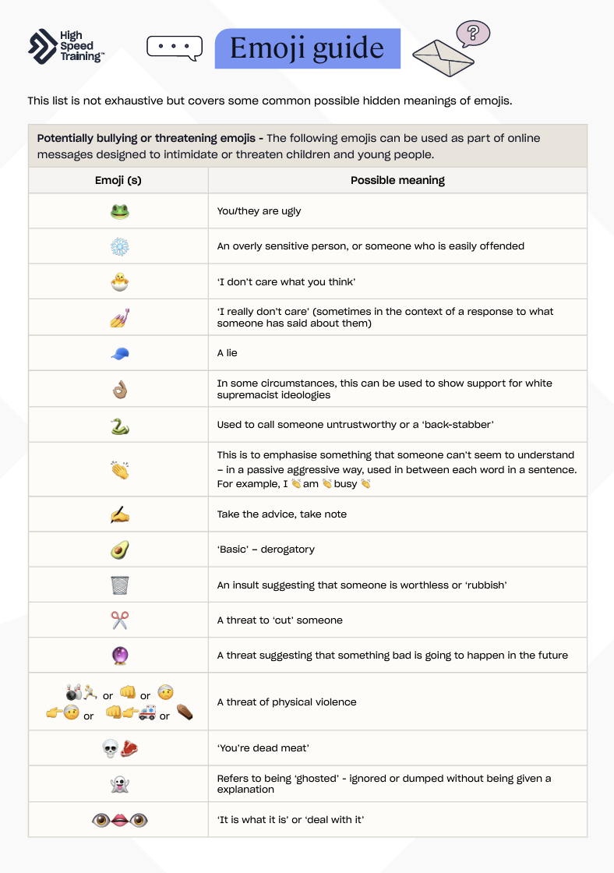
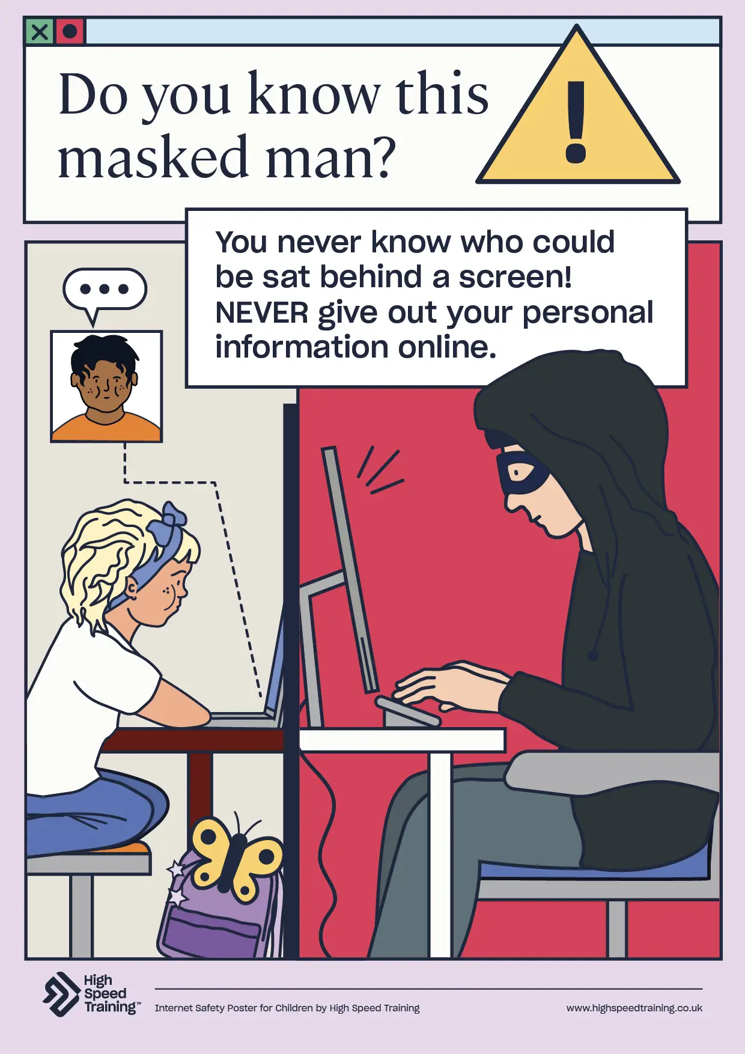
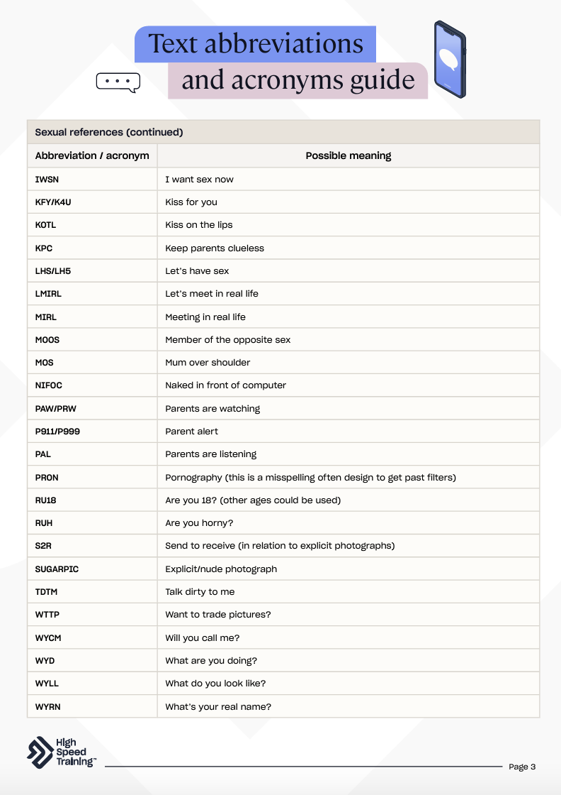



What can we do about online safety?
Keep the conversation open and engage
pupil voice
Build your awareness of the ‘hidden’ online language
Reinforce online safety guidance with your pupils, parents and carers
Displaying, and referencing, internet safety posters in your classroom can be a good way to keep pupils regularly reminded about the potential risks
There’s a wide range of useful online safety links. Examples include
CEOP Safety Centre and Internet Matters.
Notes:
Tell staff that you are going to look at what your school can do about online safety.
Some ideas to reinforce online safety might include:
Keep the conversation open and engage pupil voice
Encourage conversations about being online. You could ask your pupils about the platforms they use or use stories as conversation prompts.
A key part of online safety is about actively seeking the views of children in your school via pupil voice.
Build your awareness of the ‘hidden’ online language
The complex use of emojis and abbreviations has resulted in a ‘hidden language’ amongst young people of which many adults may not be aware, and which can cause dangers to go unnoticed.
Reinforce online safety guidance with your pupils, parents and carers
As the NSPCC states: “Embedding key messages about staying safe online throughout the curriculum helps ensure that children of all ages are taught online safety skills.”
You can regularly remind pupils, parents and carers of risks relating to online harms.
Parents should also have a clear understanding of who to voice their concerns to, or seek advice from, in relation to safeguarding issues.
Displaying, and referencing, internet safety posters in your classroom
It’s essential that children know how to keep themselves safe online and what to do when something isn’t quite right. Displaying, and referencing, internet safety posters can be a good way to inform students and keep them regularly reminded. You can download a range of posters on the link attached to this slide.
Sources of information:
https://learning.nspcc.org.uk/online-safety/online-safety-for-schools
https://www.highspeedtraining.co.uk/hub/a-guide-to-emojis-and-texting-abbreviations/?utm_source=insetpack2024&utm_medium=insetpack2024&utm_campaign=insetpack2024
https://www.highspeedtraining.co.uk/hub/internet-safety-posters-for-schools/?utm_source=insetpack2024&utm_medium=insetpack2024&utm_campaign=insetpack2024

Slide 28

6,817
In the year ending 31 March 2023, there were 6,817 referrals to Prevent.
PREVENT
The objectives of the Prevent duty were reviewed in 2023 and are to:
32%
Tackle the ideological causes of terrorism
32% of referrals related to those aged 15 to 20.
Intervene early to support people susceptible to radicalisation
Enable people who have already been engaged in terrorism to disengage and rehabilitate
31%
Those aged 14 years and under account for the second largest proportion (31%).
Notes:
Tell staff that you are going to talk about the Prevent duty.
Click to reveal that the objectives of the Prevent duty were reviewed in 2023 and are to:
Tackle the ideological causes of terrorism
Intervene early to support people susceptible to radicalisation
Enable people who have already been engaged in terrorism to disengage and rehabilitate
Next, you’ll see three statistics about Prevent. Click to reveal these one at a time.
In the year ending 31 March 2023, there were 6,817 referrals to Prevent.
32% of referrals related to those aged 15 to 20.
Those aged 14 years and under account for the second largest proportion (31%).
Sources of information:
https://www.gov.uk/government/statistics/individuals-referred-to-prevent/individuals-referred-to-and-supported-through-the-prevent-programme-april-2022-to-march-2023
https://www.counterterrorism.police.uk/new-statistics-show-increase-in-prevent-referrals/
https://www.gov.uk/government/publications/prevent-duty-guidance

Slide 29

Seeming withdrawn, isolated or excluded
Appearing to make less effort at school
Experiencing family pressure or upheaval
Indicators of radicalisation
Expressing a disregard for differing opinions
Fixated on a new subject, such as immigration
Lying to their family or other trusted adults
Adopting speech that sounds scripted
Changing their friendship groups
Notes:
Tell staff that you are now going to look at some of the indicators of radicalisation.
You could ask staff to think about what comes to their mind.
Click to reveal some examples of the indicators of radicalisation.

Slide 30

Mixed, Unclear or Unstable (MUU) Ideology
Incel stands for ‘involuntary celebate’ and is a term adopted by individuals in the incel community to describe themselves.
It promotes an extremist ideology, and presents a risk of radicalisation.
Women and girls are stereotyped, objectified and dehumanised - they are seen as genetically inferior and incels will discuss misogynistic or sexist views about them.
Notes:
Tell staff that you are now going to cover Mixed, Unclear or Unstable (MUU) Ideology.
Click to reveal the details about incel culture.
Incel stands for ‘involuntary celebate’ and is a term adopted by individuals in the incel community to describe themselves.
It promotes an extremist ideology, and presents a risk of radicalisation.
If you choose to, you can refer to the fact that incel ideology, or affiliations with incel culture, have featured in several violent attacks around the world.
A relatively recent example is from 2021, where Jake Davision shot and killed five people in Plymouth – including his own mother. He had posted hate-filled, misogynistic rants online prior to the shooting.
Explain to staff that incel culture thrives online. The increased amount of time that young people spend online in recent years means that the risk of incel influence has grown.
It has been suggested that a young person is potentially just two clicks away from radical incel forums.
Whilst self-reported research from the incel community shows that there are incels from all backgrounds, much incel ideology includes elements of racial hatred, alongside the characteristic misogyny.
Boys and young men who feel rejected and isolated are particularly vulnerable to incel ideology. The online incel community may appear to offer them a place of understanding and acceptance.
It’s crucial to reinforce that we must not assume that the incel phenomenon only has implications for secondary safeguarding practice – primary schools must be alert too.
You can help to combat these issues before they even start by providing high-quality relationships education, adopting a zero-tolerance approach to harmful sexual behaviour, prioritisng mental health and wellbeing, and promoting online safety.
Sources of information:
https://www.highspeedtraining.co.uk/hub/incel-culture-in-schools/?utm_source=insetpack2024&utm_medium=insetpack2024&utm_campaign=insetpack2024
https://www.theguardian.com/uk-news/2023/feb/12/rapid-rise-in-andrew-tate-related-cases-referred-to-prevent-by-schools
https://www.headteacher-update.com/content/best-practice/incels-safeguarding-implications-for-primary-schools
https://schoolsweek.co.uk/schools-see-rise-in-incel-extremism-prevent-referrals/

Slide 31

Are you aware of the meaning behind any of the following signs, symbols, acronyms and phrases?
88
this stands for Heil Hitler, where each 8 represents the letter H
(being the eighth letter of the alphabet)
18
as above, but where the 1 (A) and the 8 (H) represent Adolf Hitler’s initials.
ORION
Our Race is Our Nation
Red pill
a reference to the film The Matrix. To have ‘taken the red pill’ means to have realised the ‘truth’ about women and society.
Chad
a man who is sexually attractive to women (an alpha)
You may see these in the form of graffiti,
doodles in books, badges or stickers.
SWP
Supreme White Power
Notes:
Tell staff that they are going to see 6 different signs, symbols, acronyms and phrases that may indicate affiliation with an extremist ideology.
Click to reveal the first one, and ask staff to discuss whether they are aware of what this means. Then click to reveal the answer and move onto the next.
88 → this stands for Heil Hitler, where each 8 represents the letter H (being the eighth letter of the alphabet)
18 → as above, but where the 1 (A) and the 8 (H) represent Adolf Hitler’s initials.
ORION → Our Race is Our Nation
Red pill → a reference to the film The Matrix. To have ‘taken the red pill’ means to have realised the ‘truth’ about women and society.
Chad → a man who is sexually attractive to women (an alpha)
SWP → Supreme White Power
Many adults will be unaware of the significance of this slang. Children and young people may hear and repeat these terms without necessarily understanding their meaning or ideological roots.
By being aware of these terms, staff and parents will be better able to spot any cause for concern in a young person’s communication. This can act as a warning sign that would warrant further discussion and exploration.
Advise staff that they may see these in the form of graffiti, doodles in books, badges or stickers.
Sources of information:
https://www.highspeedtraining.co.uk/hub/incel-culture-in-schools/?utm_source=insetpack2024&utm_medium=insetpack2024&utm_campaign=insetpack2024

Slide 32



MENTAL HEALTH
of mental illnesses start before a child reaches
their 18th birthday
of young people feel embarrassed about
mental illness
of school children
have diagnosable
mental illness
75%
51%
10%
According to a survey conducted by The Children’s Society, 18% of young people would go to their
teachers for support when they are feeling down.
Notes:
Tell staff that you are going to talk about mental health.
We know that prioritising good mental health in children is vital, as a child’s emotional health and wellbeing influences their cognitive development, mental wellbeing, and their physical and social health.
Let staff know that they are going to see some statistics on screen, and that you want them to discuss what they think the results will be.
Click to reveal the first box, and ask staff: what percentage of mental illnesses do you think start before a child reaches their 18th birthday?
Gather answers from one or two members of staff, then click to reveal the result (75%).
Click to reveal the second box, and ask staff: what percentage of young people do you think said that they feel embarrassed about mental illness?
Gather answers from one or two members of staff, then click to reveal the result (51%).
Click to reveal the third box, and ask staff: what percentage of school children do you think reported a diagnosable mental illness?
Gather answers from one or two members of staff, then click to reveal the result (10%).
Click to reveal the final statistic, showing that 18% of young people would go to their teachers for support when they are feeling down.
Ask staff to discuss whether these statistics surprise them or not.
Sources of information:
https://www.mqmentalhealth.org/young-people-mental-health-statistics/
https://www.childrenssociety.org.uk/sites/default/files/2020-11/inside_the_mind.pdf

Slide 33
Destructive behaviour
Changes in eating habits
Having educational difficulties
Withdrawal and lack of enthusiasm for things previously enjoyed
Signs to look out for
Tiredness and stress
Heightened emotions, such as excessive crying or hyperactivity
All staff should be aware that mental health problems can, in some cases,
be an indicator that a child has suffered or is at risk of suffering abuse, neglect or exploitation.
Lack of confidence
Notes:
Tell staff that you are now going to look at some signs to look out for that may indicate a mental health issue.
You could ask staff to think about what comes to their mind.
Click to reveal a number of signs that you should look out for regarding mental health.

Slide 34




How can we support positive mental health?
Encourage social time
Have an open-door policy
Let the child share as much or as little as they want to
Make mental health known and talk about ways of dealing with stress and pressure
Remember that only appropriately trained professionals should attempt to make a diagnosis of a mental health problem, but you are well placed to observe children day-to-day and identify concerns.
Notes:
Tell staff that you are going to look at how you can support positive mental health in your school.
Talking to the child or young person is often the first step in helping them. In doing so, you can discover what's troubling them and what you can do to help.
Some ideas to support positive mental health might include:
Encourage social time
This might involve encouraging children to chat with their peers and complete a task together, like a difficult problem or a challenge.
Have an open-door policy
It’s essential that students know they can come and talk to you about any issues or concerns they have. Communicate this to your students so they know you’re always there to listen.
Let the child share as much or as little as they want to
Keep your questions open-ended to give the child or young person the chance to say what they choose to and ensure the conversation takes place where the child feels comfortable. They should lead the discussion and not be pressured to talk.
Make mental health known
Sadly, mental health is something that some children may feel embarrassed to talk about. Many also feel judged if they explain their problems. As a result, it’s important to make time to discuss the topic, address it in assemblies, and celebrate awareness days, like World Mental Health Day, to let students know they’re not alone.
Remind staff that only appropriately trained professionals should attempt to make a diagnosis of a mental health problem, but you are well placed to observe children day-to-day and identify concerns.
If you suspect that a child is struggling, then it's important to follow your school’s policies and procedures. Be prepared to ask any questions around this.
Sources of information:
https://www.highspeedtraining.co.uk/hub/promoting-mental-health-in-schools/?utm_source=insetpack2024&utm_medium=insetpack2024&utm_campaign=insetpack2024

Slide 35
92%
of girls and
74%
of boys
said sexist name-calling happens a lot or sometimes to them or their peers
CHILD-ON-CHILD ABUSE
All staff should be aware that children can abuse other children at any age, and that it can happen both inside and outside of school and online.
Sexual Violence and
Sexual Harassment is a form of child-on-child abuse.
Between 2019 and 2022, data suggested a
40%
increase in reports of sexual assaults and rapes where both the alleged victim and perpetrator were under 18
33%
increase in rape reports and a 26% increase in reports where the allegation was against a child aged
under 10
33%
Notes:
Tell staff that you are going to talk about child-on-child abuse.
Click to reveal the description of child-on-child abuse.
Children are capable of abusing their peers, even at a young age. This can come in the form of violence towards another student, sexual assault, or emotional abuse.
All staff should be aware that it can happen both inside and outside of school and online.
Click to reveal three statistics, one at a time:
Data from police forces in England and Wales between 2019 and 2022 suggested a:
40% increase in reports of sexual assaults and rapes where both the alleged victim and perpetrator were under 18.
33% increase in rape reports and a 26% increase in reports where the allegation was against a child aged under 10.
A report carried out by Ofsted revealed that 92% of girls and 74% of boys said sexist name-calling happens a lot or sometimes to them or their peers.
Sources of information:
https://www.theguardian.com/society/2024/feb/17/toxic-online-culture-fuelling-rise-in-sexual-assualts-on-children-by-other-children-police-warn
https://www.theguardian.com/society/2024/jan/10/children-now-biggest-perpetrators-of-sexual-abuse-against-children
https://anti-bullyingalliance.org.uk/aba-our-work/news-opinion/review-sexual-abuse-schools-and-colleges
https://publications.parliament.uk/pa/cm5803/cmselect/cmwomeq/331/report.html#:~:text=Most%20girls%20and%20boys%2C%2092,such%20behaviour%20had%20become%20normal.
https://assets.publishing.service.gov.uk/media/6650a1967b792ffff71a83e8/Keeping_children_safe_in_education_2024.pdf

Slide 36

Bullying and cyberbullying
This can include
Upskirting, which typically involves taking a picture under a person’s clothing without their permission
Abuse in intimate personal relationships between peers
Sexual comments, remarks, jokes and online sexual harassment
Consensual and non-consensual sharing of sexual images and videos (also known as sexting)
Acts of violence and physical abuse (such as hitting, kicking, shaking, biting or hair pulling)
Notes:
Tell staff that you are now going to look at what child-on-child abuse can include.
You could ask staff to think about what comes to their mind.
Click to reveal some examples of child-on-child abuse.
Sources of information:
https://assets.publishing.service.gov.uk/media/6650a1967b792ffff71a83e8/Keeping_children_safe_in_education_2024.pdf

Slide 37




How can we prevent, and respond to, child-on-child abuse?
Challenge inappropriate behaviours between children
Have systems in place for children to confidently report abuse
Don’t tolerate or dismiss sexual violence or harassment
Recognise that a child who has harmed other children may have unidentified needs of
their own
Remember that you should consider the potential impact of social media.
Notes:
Tell staff that you are going to look at how you can prevent, and respond to, child-on-child abuse.
Some ideas might include:
Challenge inappropriate behaviours between children
Staff should make it clear that it is not acceptable, will never be tolerated, and is not an inevitable part of growing up.
Have systems in place for children to confidently report abuse
Reinforce the systems that your school has in place regarding how allegations of child-on-child abuse will be recorded, investigated and dealt with.
Don’t tolerate or dismiss sexual violence or harassment
This means not dismissing sexual violence or harassment as “banter”, “part of growing up”, “just having a laugh” or “boys being boys”.
Recognise that a child who has harmed other children may have unidentified needs of their own
They may require external agency support where appropriate.
Remind staff that you should consider the potential impact of social media.
Sources of information:
https://assets.publishing.service.gov.uk/media/6650a1967b792ffff71a83e8/Keeping_children_safe_in_education_2024.pdf

Slide 38
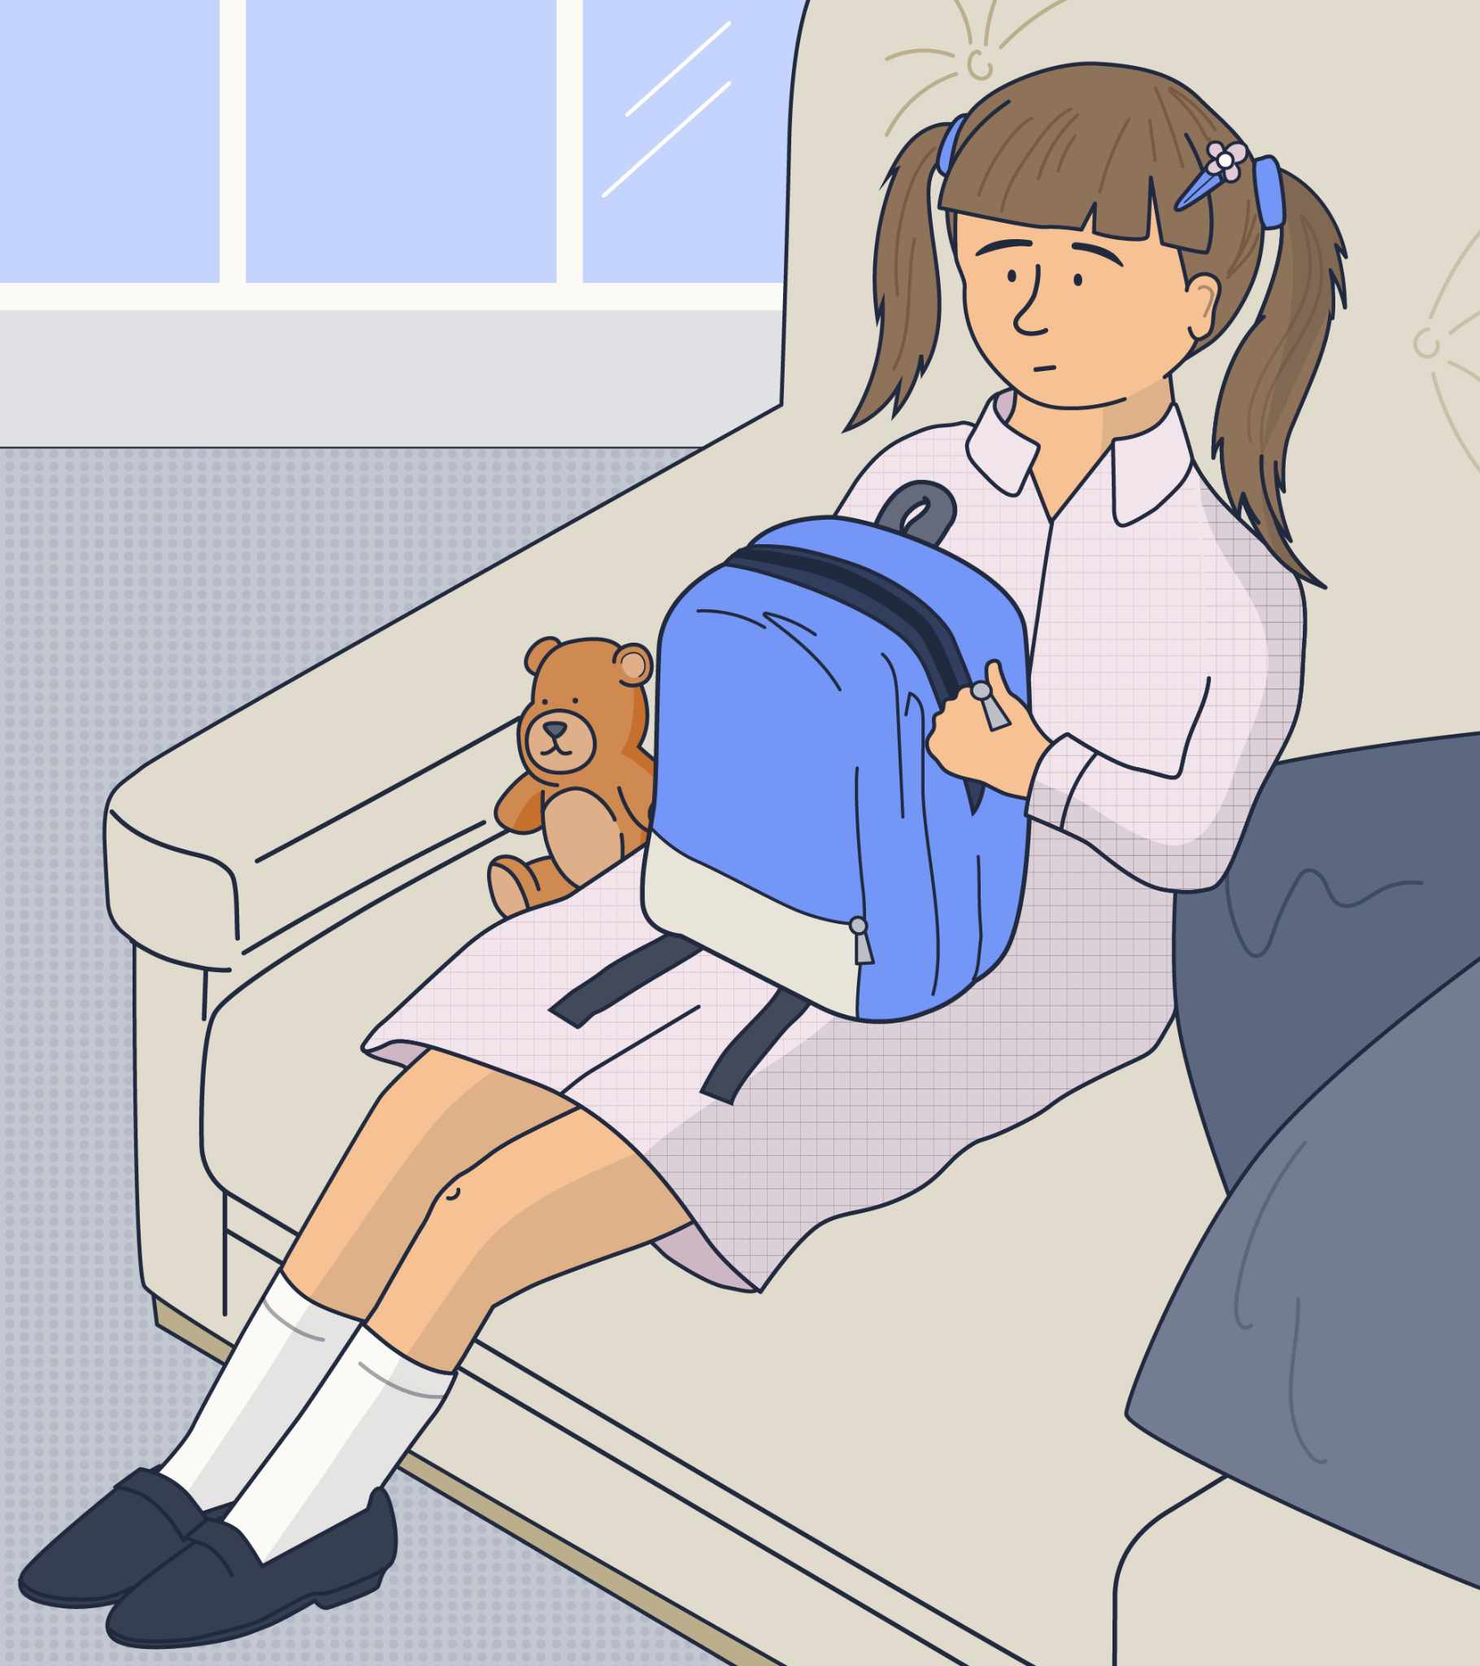
Lucy, aged 7
Lucy’s parent asked to have a conversation with you at drop-off time this morning. Her Mum said that she has been extremely quiet when she comes home from school lately and no longer wants to participate in arts and crafts club after school but she doesn’t understand why. As Lucy is autistic, her Mum stressed the importance of attending after school club as part of her routine.
In addition to this, you recognise that Lucy isn’t speaking to her usual friendship group at lunch time.
Scenario A
Notes:
Explain to staff that you are now going to look at some safeguarding scenarios.
Click to present Scenario A (Lucy, aged 7).
Ask staff to discuss the scenario. Do they feel that it constitutes a safeguarding issue? If so, what action might they take?
Explain to staff that this has the potential to be a safeguarding issue (linking to what you have presented earlier in the session regarding child-on-child abuse).
It’s important to think about why Lucy no longer wants to attend the after school club, and any connection this may have to her no longer speaking to her usual friendship group at lunch time. You should also consider that as Lucy is autistic, this may make her more susceptible to child-on-child abuse.

Slide 39
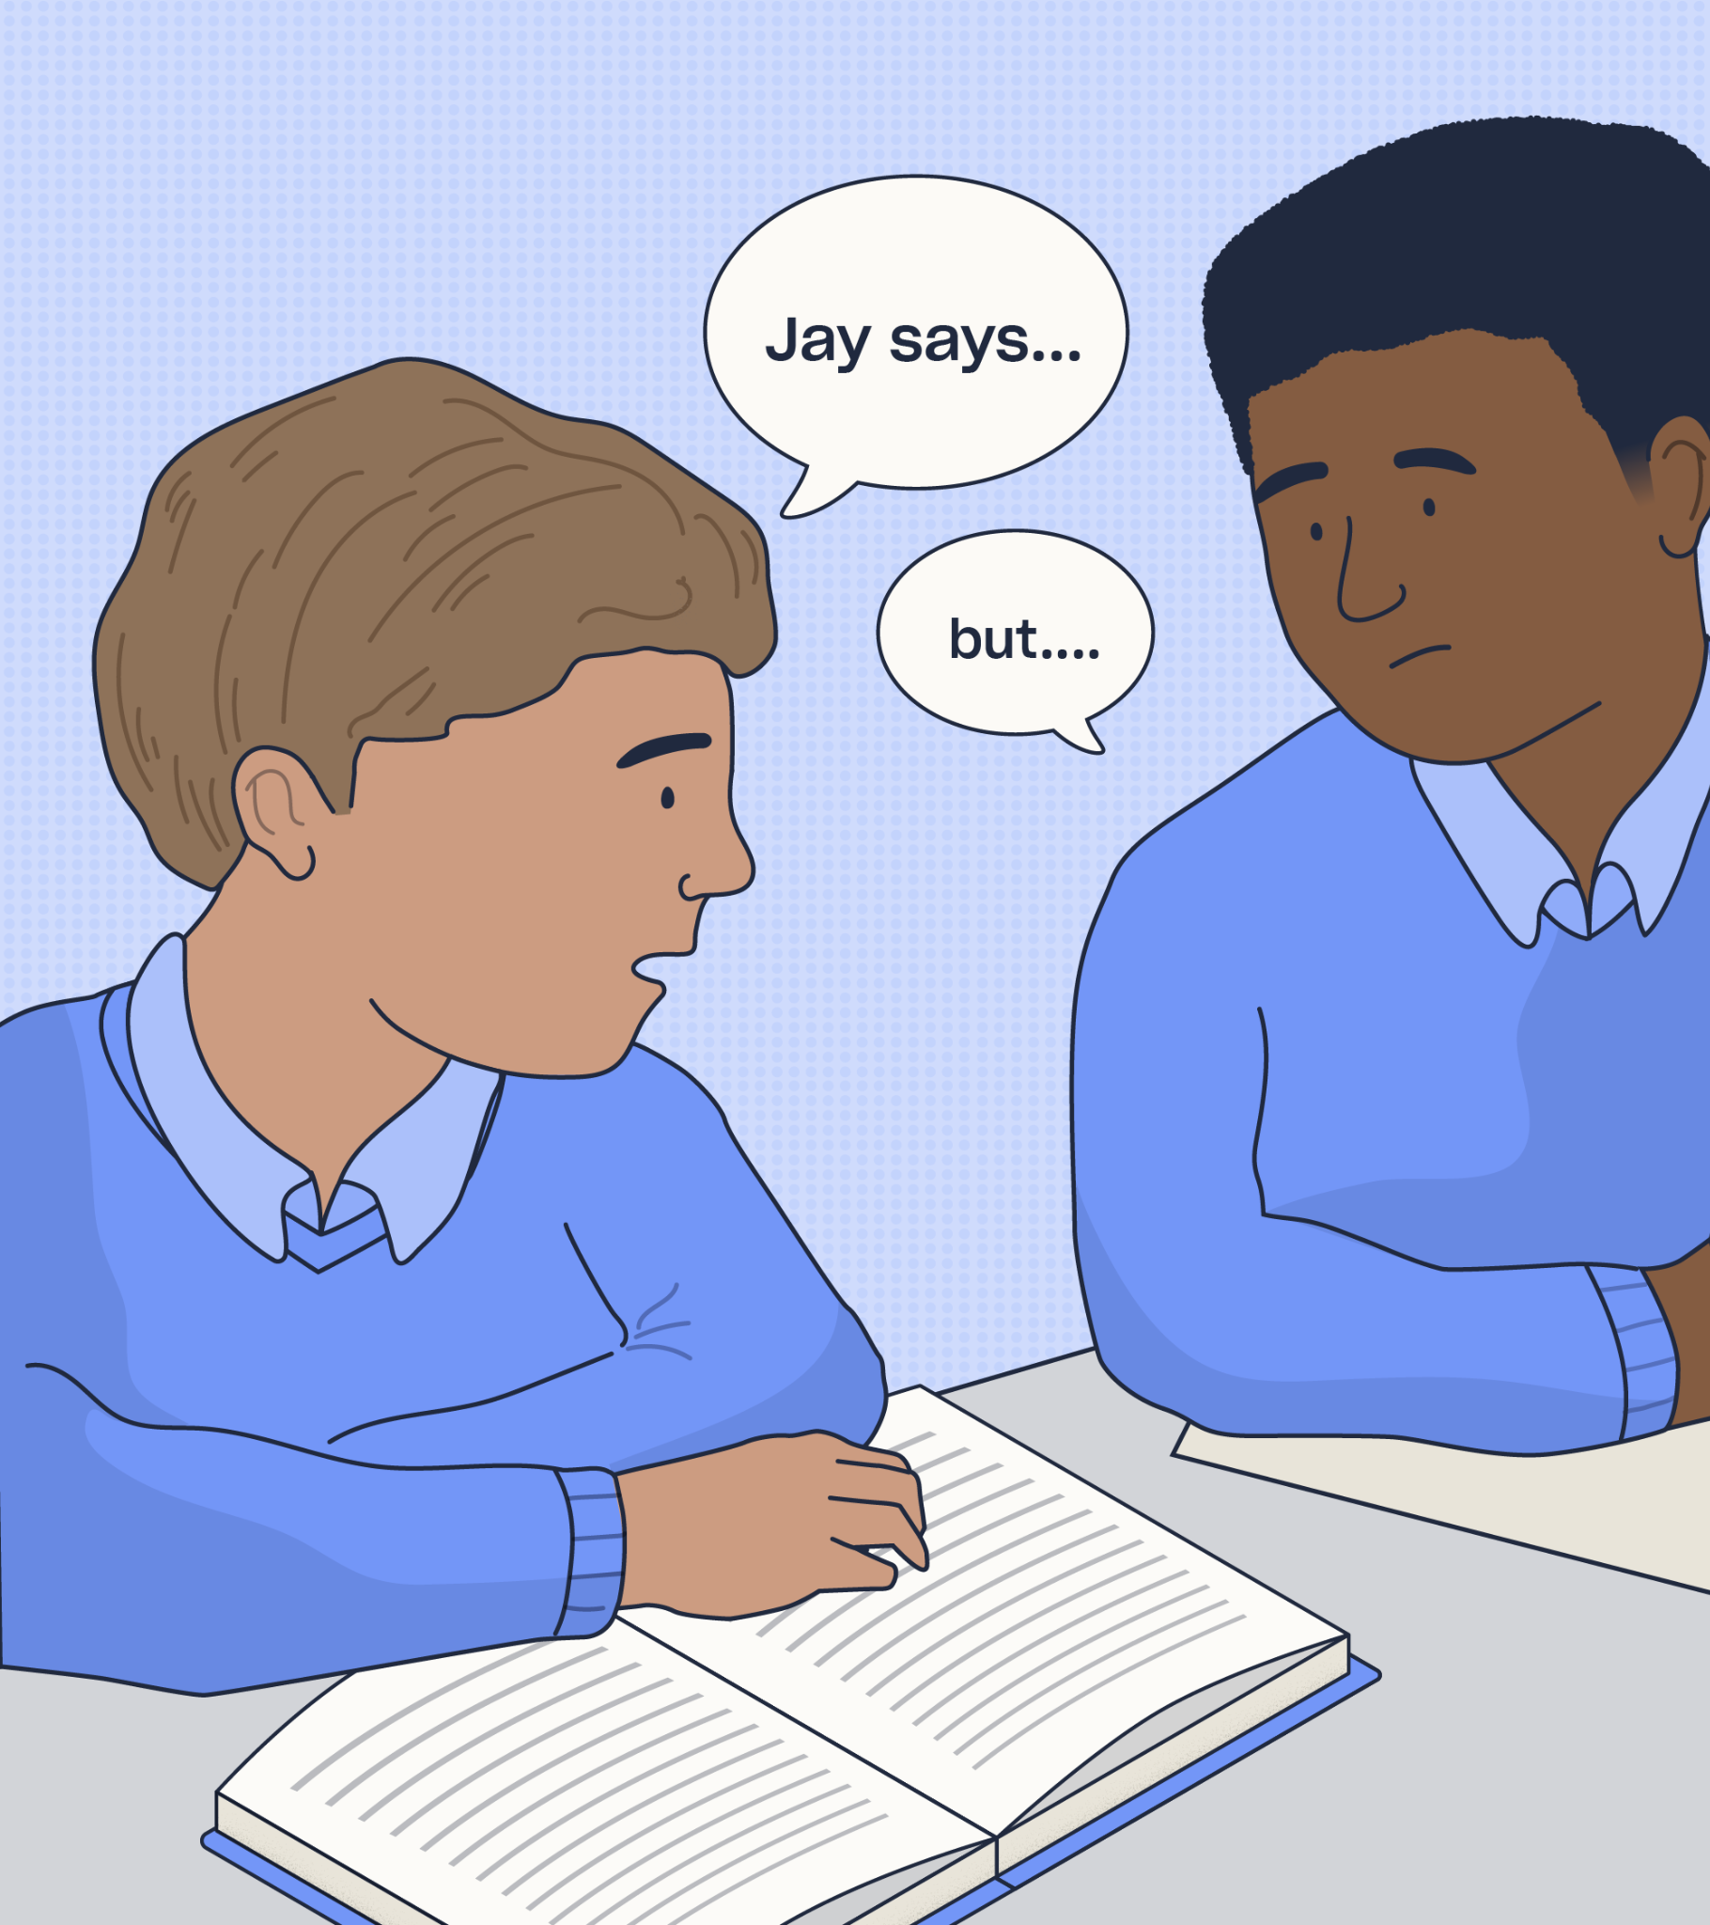
Samuel, aged 10
In class, you overhear a group of pupils discussing their new friend “Jay” who you have never heard of before. It transpires that this is someone that the boys talk to while gaming online, and Samuel in particular has formed a close relationship with him. One of the friendship group, Luke, referred to a gift that Jay had bought for Samuel.
Samuel suddenly appeared very quiet after glaring at Luke, and dismissed the conversation with you.
Scenario B
Notes:
Click to present Scenario B to staff (Samuel, aged 10).
Ask staff to discuss the scenario. Do they feel that it constitutes a safeguarding issue? If so, what action might they take?
Explain to staff that this has the potential to be a safeguarding issue (linking to what you have presented earlier in the session regarding online safety).
Many games are designed to be played in teams or against other people and thus children can be playing and communicating with players from many different locations, ages, and backgrounds. The anonymity behind an online presence means that children could be at risk of grooming, online abuse, or forming relationships with people who could have ill intent.

Slide 40
Summary
You must be able to identify the warning signs that could indicate a child’s welfare is at risk.
The most important thing to remember is to report any suspicions you have, even if you aren’t certain.
Notes:
Provide a summary of the section that you have just covered on some of the key safeguarding issues.
Offer the opportunity for staff to ask any questions that they may have following this section.

Slide 41
Further resources and training
If you would like to find out more about the topics we’ve covered in this section, visit the following links:
Internet Safety Posters for Schools
Online Safety & Harms Training
How to Tackle Incel Culture in Schools
Prevent Duty Training
How to Support SEMH in Schools
Child Mental Health Training
What You Need to Know About Sextortion
CPD Courses for Teaching and Education
Notes:
If staff would like to find out more about topics covered in this section, advise them that they can visit the links as shown.

Slide 42
Reporting safeguarding concerns
Write your school name here
4
Notes:
The fourth section of today’s session will focus on reporting your safeguarding concerns.
You’ll cover the do’s and don’ts of responding to a disclosure and understand your school’s procedures for reporting concerns.

Slide 43
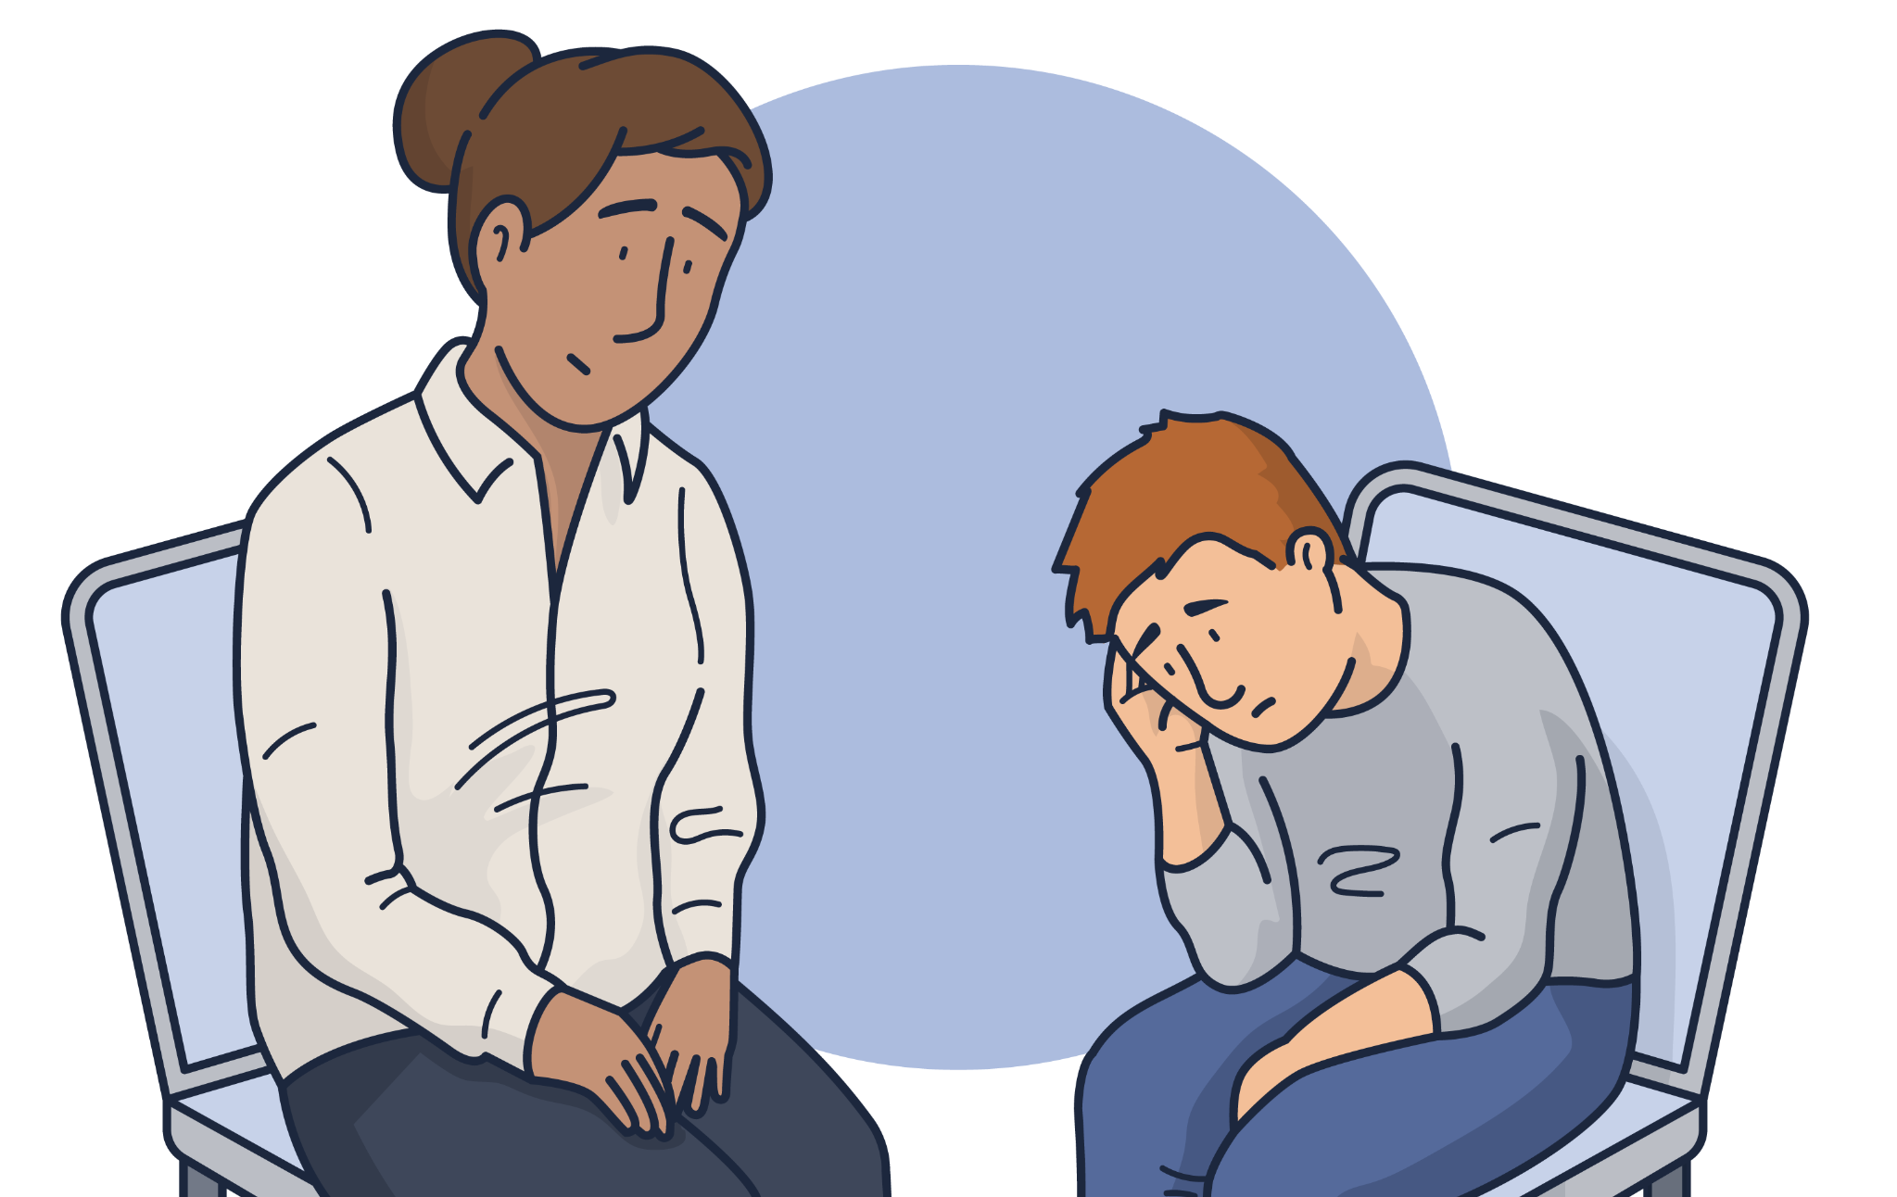
Responding to a disclosure
Do’s
Don'ts
✓ Remain calm and level-headed
✓ Reassure the child
✓ Listen carefully and actively
✓ Ask open-ended questions to clarify the
child’s version of events
✓ Let them know that you are taking what
they say seriously
✓ Tell them what will happen next
✓ Make a note of exactly what they
have told you as soon as possible
with dates and times
✓ Share the concern
following procedure
✘ Promise to keep secrets
✘ Rush the child’s account
✘ Ask leading questions or try to interview the child
✘ Make assumptions
✘ Show that you are upset
or angry
✘ Show disbelief or dismiss them
✘ Talk negatively about the potential abuser
Notes:
Explain to staff that your school should aim to create an effective culture of safeguarding where children feel able to share their concerns and where they know that they will be listened to and taken seriously.
Children - especially young children - may repeat or re-enact something that has happened to them.
It is important that you are aware of how a child might disclose information and be confident about what to do if they did.
Click to reveal the do’s.
Click to reveal the don’ts.

Slide 44
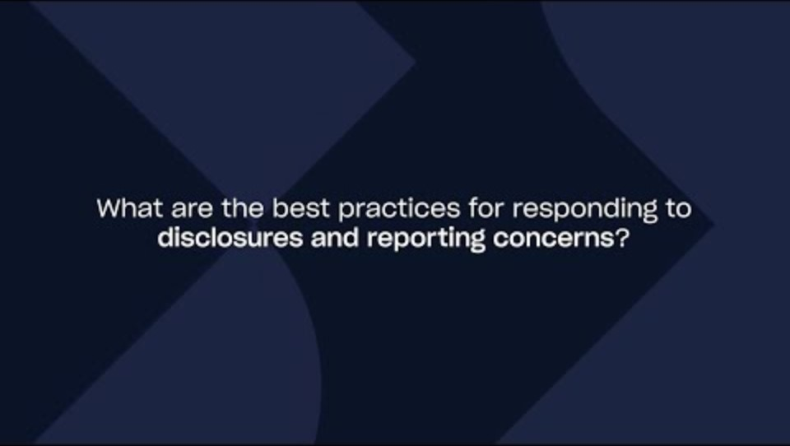
Notes:
Video content: when presenting the slide, click on the play icon to start the video (02:07).
In this video, you’ll hear from Joanna Nicolas and Debbie Innes-Turnill.
The video provides guidance around responding to a disclosure and reporting your concerns.
If you need the link to access the video, you can find it here: https://youtu.be/ch_5sTmIvX4

Slide 45

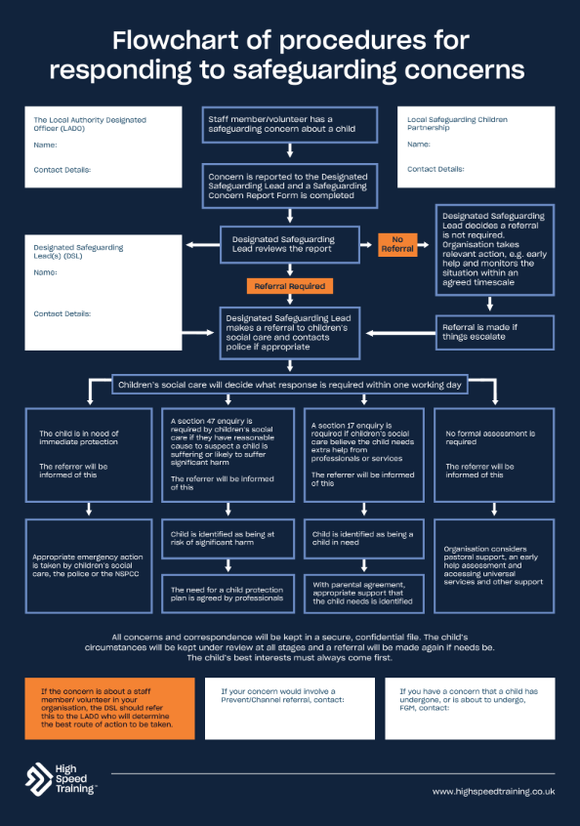
We all have a duty to keep people safe and act on our concerns
Staff member/volunteer has a
safeguarding concern about a child
Concern is reported to the Designated
Safeguarding Lead and a Safeguarding
Concern Report Form is completed
Designated Safeguarding Lead reviews the report
No referral
Referral required
Designated Safeguarding Lead
makes a referral to children’s social care and contacts police if appropriate
Displaying a safeguarding flowchart helps to show what
you should do if you have a concern about a child, who you
should report it to, and the lines of enquiry and procedure that will be taken.
Notes:
Please note: you can download this editable safeguarding flowchart within your pack.
If a member of staff has any concerns about a child, or the child discloses information to them, then they should report concerns to the DSL straight away.
Go through what happens when a member of staff reports a concern, reflecting on your school’s procedures.
Sources of information:
https://www.highspeedtraining.co.uk/hub/safeguarding-flowchart/?utm_source=insetpack2024&utm_medium=insetpack2024&utm_campaign=insetpack2024

Slide 46
Summary
If you have any concerns about a child, you absolutely must report them.
Don’t jump to conclusions or even solutions when talking to the child, just make sure you are fully listening to them at that moment.
You should not assume that it could never happen in our school.
Notes:
Provide a summary of the section that you have just covered on reporting safeguarding concerns.
Offer the opportunity for staff to ask any questions that they may have following this section.

Slide 47
Further resources and training
If you would like to find out more about the topics we’ve covered in this section, visit the following links:
Safeguarding Flowchart: Procedure for Reporting Concerns
Introduction to Safeguarding Children Training Course (Level 1 Safeguarding)
Advanced Safeguarding Children (Level 2 Safeguarding)
Designated Safeguarding Lead Training
Notes:
If staff would like to find out more about topics covered in this section, advise them that they can visit the links as shown.

Slide 48
Creating an effective culture of safeguarding
Write your school name here
5
Notes:
The fifth section of today’s session will focus on creating an effective culture of safeguarding.
You’ll cover what a safeguarding culture means, why it is important and the steps that all members of staff can take towards creating and maintaining an effective culture of safeguarding within your school.

Slide 49
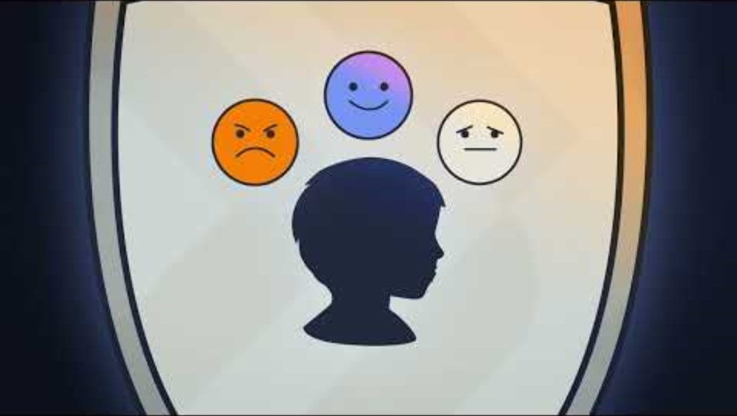
Notes:
Video content: when presenting the slide, click on the play icon to start the video (01:10).
The following video presents an animation to help staff understand what is meant by a safeguarding culture.
If you need the link to access the video, you can find it here: https://youtu.be/cRfD2e6KBLE?si=vRm_vu_Z5fiMnrfp

Slide 50
Discussion point
How confident do we feel in the culture of safeguarding at our school?
Notes:
Discussion point: how confident do we feel in the culture of safeguarding at our school?
Allow time for discussion and then take some of the answers to summarise thoughts from the group.

Slide 51
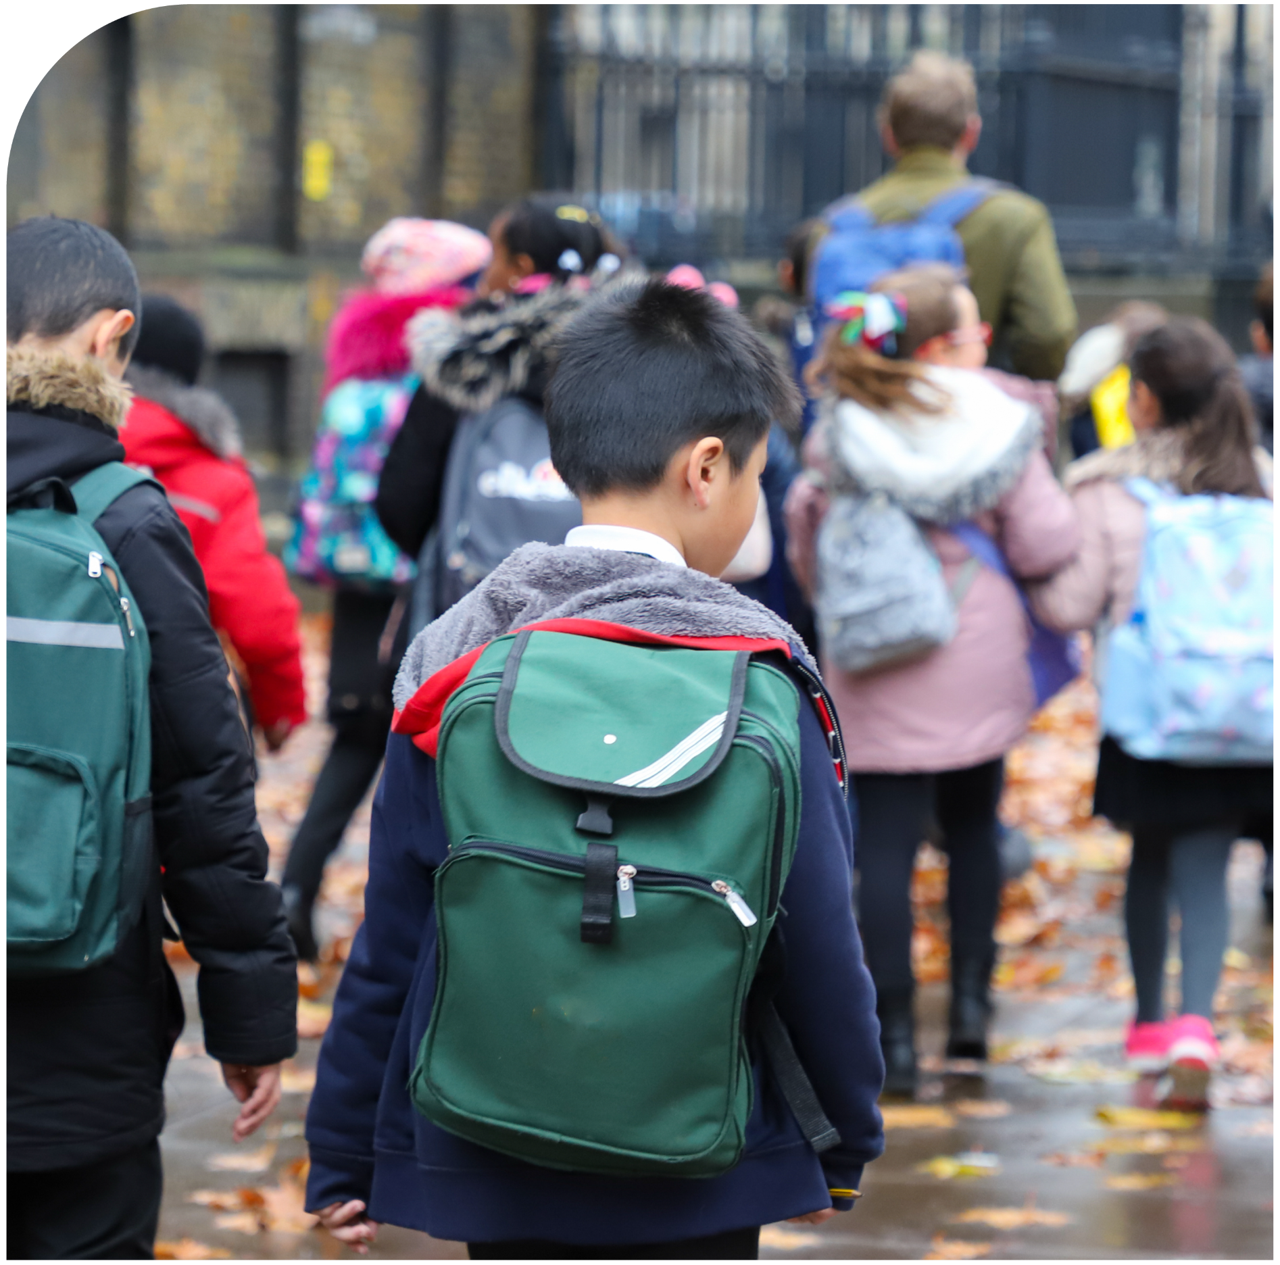
‘It could happen here, and it probably is.’
An effective safeguarding culture should be one of vigilance, and the cornerstone of vigilance is accepting that issues can occur in our school.
Professional curiosity and the willingness to provide professional challenge, where appropriate, are essential.
VIGILANCE
Notes:
Vigilance is crucial to an effective culture of safeguarding.
This means accepting that issues can, and may well, occur in your school.
Explain that there have been many cases in organisations where safeguarding has fallen short, and concerns have not been acted upon, due to attitudes such as ‘it couldn’t happen here’.
Professional curiosity and the willingness to provide professional challenge, where appropriate, are essential.
Some tips on how to be professionally curious might include:
Know the signs to look out for, respectfully ask questions and investigate, understand the ‘whole picture’, raise concerns and challenge decisions.
Staff also need to appreciate that children will often not disclose abuse, or in some cases, even realise that abuse is taking place.
Sources of information:
https://www.highspeedtraining.co.uk/hub/professional-curiosity/?utm_source=insetpack2024&utm_medium=insetpack2024&utm_campaign=insetpack2024
https://www.highspeedtraining.co.uk/hub/culture-of-safeguarding-in-schools/?utm_source=insetpack2024&utm_medium=insetpack2024&utm_campaign=insetpack2024

Slide 52

Policies and procedures
The policies and procedures that we have in place must be lived and breathed by everyone in our school in order for it to be successful.
It is incredibly important that all staff feel confident using the systems that we have in place. If anyone has any queries please contact
>>ENTER DETAILS HERE<<
Notes:
Effective policies and procedures provide the foundation of an effective safeguarding culture, as they set out your organisation’s safeguarding expectations.
Be prepared to ask any questions that staff may have about your school’s policies and procedures.
Sources of information:
https://www.highspeedtraining.co.uk/hub/culture-of-safeguarding-in-schools/?utm_source=insetpack2024&utm_medium=insetpack2024&utm_campaign=insetpack2024

Slide 53

Contextual safeguarding
Contextual safeguarding is an approach to safeguarding that recognises that young people may be at risk of significant harm not only within their home environment, but also outside it.
While you don’t need to take on all of the problems in our local area yourself, you should use your role – where you spend a significant amount of time with young people, and know and understand both them and your local community – to make a difference.
Notes:
Contextual safeguarding is an approach to safeguarding that recognises that young people may be at risk of significant harm not only within their home environment, but also outside it.
It addresses the underlying causes, not just the effects.
Let staff know that you are going to explain some of the possible actions you could begin to take, which might include:
Consider the culture of your school or college. Is it a safe and supportive environment? If not, how could you make it more so?
Consider the location that you live and work in, and assess the risks that young people may be exposed to outside of school, as well as inside it.
Create a safe space for young people and/or their families to talk to you about their experiences. What they tell you about their community and the context that they are growing up in could help you to spot concerns that you may not have been aware of otherwise.
You could also help to increase awareness for parents about how to recognise signs of exploitation or abuse, how young people can stay safe online and offline, and who to contact if they notice any warning signals.
Sources of information:
https://www.highspeedtraining.co.uk/hub/what-is-contextual-safeguarding/?utm_source=insetpack2024&utm_medium=insetpack2024&utm_campaign=insetpack2024
https://www.highspeedtraining.co.uk/hub/culture-of-safeguarding-in-schools/?utm_source=insetpack2024&utm_medium=insetpack2024&utm_campaign=insetpack2024

Slide 54
Summary
An awareness of what constitutes effective safeguarding, and how to promote it, should be embedded within each and every aspect of the
school culture.
We need to avoid attitudes such as “it couldn’t happen here” and remember to remain vigilant.
It is essential that all policies and procedures are clearly understood, accessible and communicated effectively.
Contextual safeguarding is an important addition to the current safeguarding approach, and has been found to make it even more effective.
Notes:
Provide a summary of the section that you have just covered on creating an effective culture of safeguarding.
Offer the opportunity for staff to ask any questions that they may have following this section.

Slide 55
Further resources and training
If you would like to find out more about the topics we’ve covered in this section, visit the following links:
What is Contextual Safeguarding & Why is it Important?
What is Professional Curiosity in Safeguarding?
What is the Purpose of School Policies?
How to Create an Effective Culture of Safeguarding in Schools
Notes:
If staff would like to find out more about topics covered in this section, advise them that they can visit the links as shown.

Slide 56
Final thoughts for today’s session
Write your school name here
6
Notes:
The final section of today’s session will focus on some key takeaways.
It will allow you to reflect on what you’ve covered in the presentation and think about next steps.

Slide 57
Discussion point
What would you consider your top priorities with regards to safeguarding over the coming months?
Notes:
Now that you are coming to the end of today’s session, there’s a chance to reflect on your knowledge.
Discussion point: what would you consider to be your top priorities with regards to safeguarding over the coming months?
Allow time for discussion and then take some of the answers to summarise thoughts from the group.

Slide 58
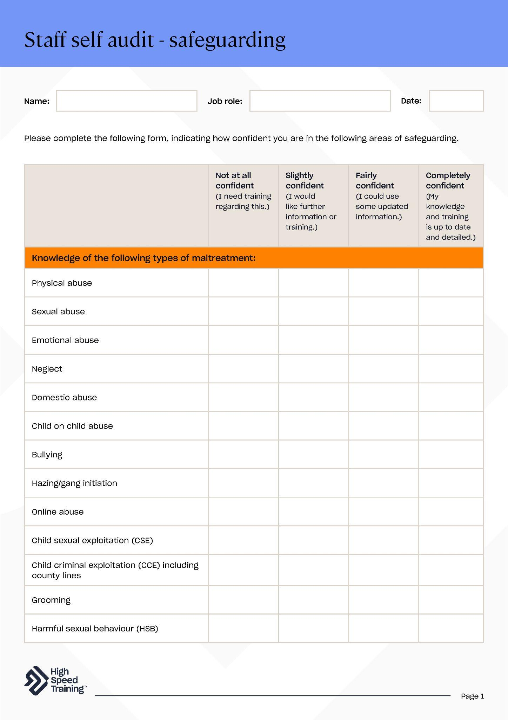

Staff self audit
Please reflect on your levels of confidence in the key areas of safeguarding by completing this form to help us assess where additional support may be required.
Notes:
Please note: you can download this editable form within your pack.
Explain to staff that it’s important for everyone to reflect on their levels of confidence in the key areas of safeguarding on a regular basis.
Distribute the form for staff to complete and ask them to return it to you to help highlight training priorities.
There’s also a variety of handouts in the pack that you may wish to distribute at this point, as you reach the end of the presentation.

Slide 59




High Speed Training is a leading provider of online training courses, designed to make training, compliance and development simple, effective and rewarding for all organisations.
Trusted by thousands of UK organisations, our fully accredited and award-winning online training and easy to use platform has seen over 3 million learners take the next steps in their careers.
You can also find the most up-to-date, practical information and resources produced by our experts to support you in your professional life on our company blog, the Hub.
Notes:
Brought to you by High Speed Training.
For over a decade High Speed Training has delivered online CPD courses to teachers, teaching assistants, and education professionals all across the UK.
You can browse the entire range of online training courses to build on existing knowledge or learn new skills to help you in the classroom.
In addition, you can find a wide range of free articles and resources on the Hub.

Slide 60

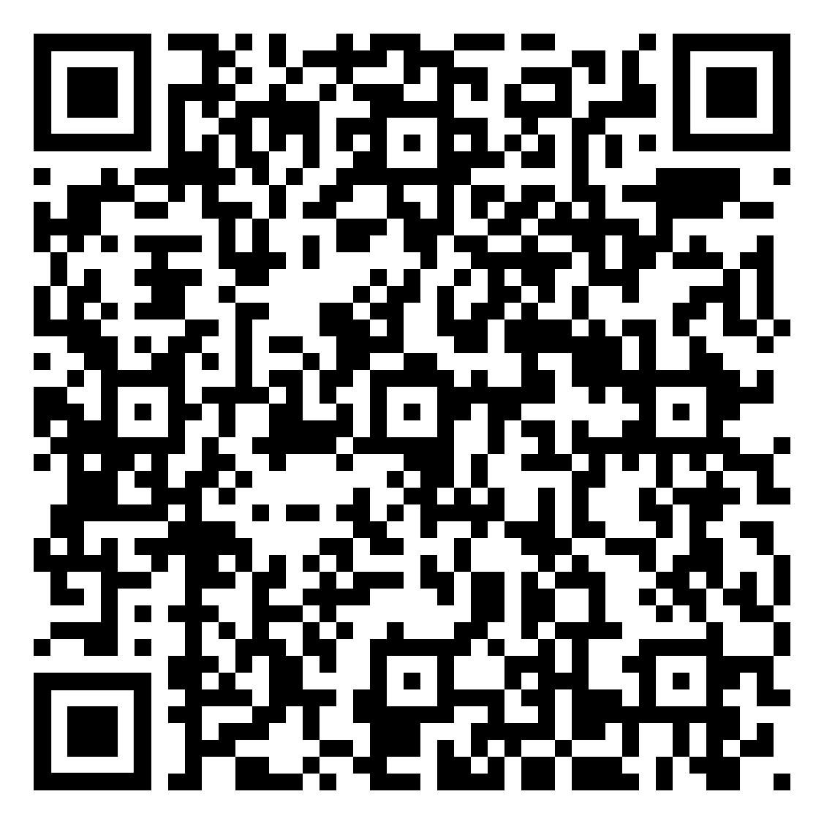

We would love to hear your feedback!
https://forms.gle/djQ1bQuFzxvMa7dXA
Complete a survey with your thoughts on this Safeguarding INSET pack for a chance to win a £100 Amazon voucher
Notes:
We value your feedback to help us improve our resources to better meet your needs in the future (High Speed Training would love to hear from you!).
All members of staff in today’s session can complete a survey with their thoughts on this INSET pack for a chance to win a £100 Amazon voucher.
You can scan the QR code on the slide to fill out the form, or you can visit the link as shown (https://forms.gle/djQ1bQuFzxvMa7dXA).

